Slide 1





Liquifusion AI
Smart cross-chain liquidity optimizer

Slide 2
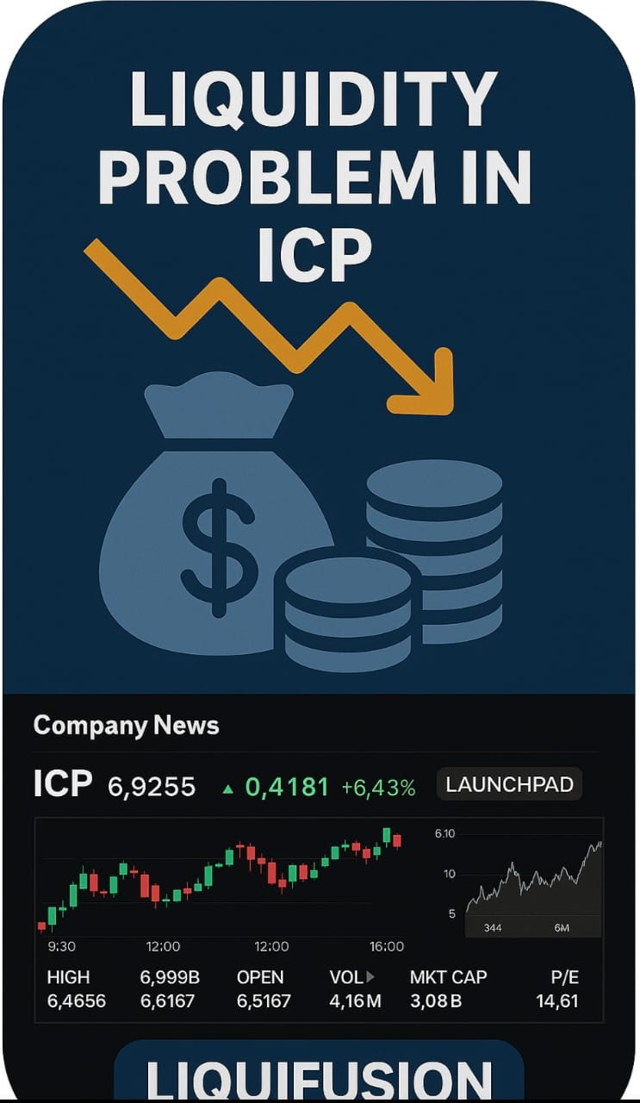

PROBLEM STATEMENT
1
Liquidity is scattered across different blockchains, making DeFi inefficient and hard to use.
Manual and risky cross-chain management leaves assets open to hacks and lost opportunities.
DeFi urgently needs an intelligent, secure system to unify and protect liquidity across all chains.
Insert Your Image Here

Slide 3
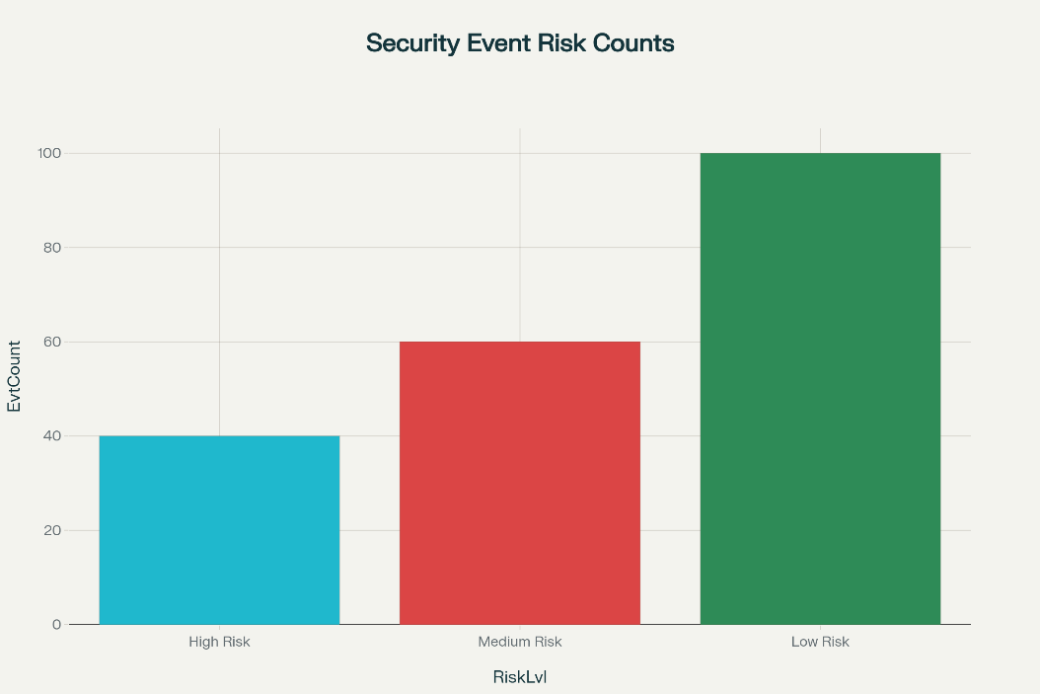
[State your problem here clearly]
1
DeFi platforms face many security threats like fraud and risky transactions that can cause huge financial losses.
LiquiFusion AI detects and categorizes these threats in real time into High, Medium, and Low risk levels.
The bar graph shows the count of security events per risk category, helping prioritize actions and demonstrate the system’s protective impact.

Slide 4


Existing players solving it...but poorly
2
Chain alysis
Elliptic
Nansen
DeFiSafety
Expensive, enterprise-focused
Real-time monitoring
Real-time analytics
Transparent audit ratings
Advanced compliance tools
Less for small projects
User-friendly dashboards
Peer-reviewed methodology
Accurate transaction analytics
Broad ecosystem integration
Weak compliance tools
Limited real-time monitoring

Slide 5
Here’s how our approach stands out...
3
Real-time, on-chain AI blocks risky transactions before they execute, offering immediate protection—not just alerts after the fact.
Native cross-chain liquidity routed directly via ICP Chain-Key cryptography—no bridges, no central points of failure.
Continuous, transparent AI-driven optimization and security, fully decentralized within the ICP canister ecosystem.

Slide 6
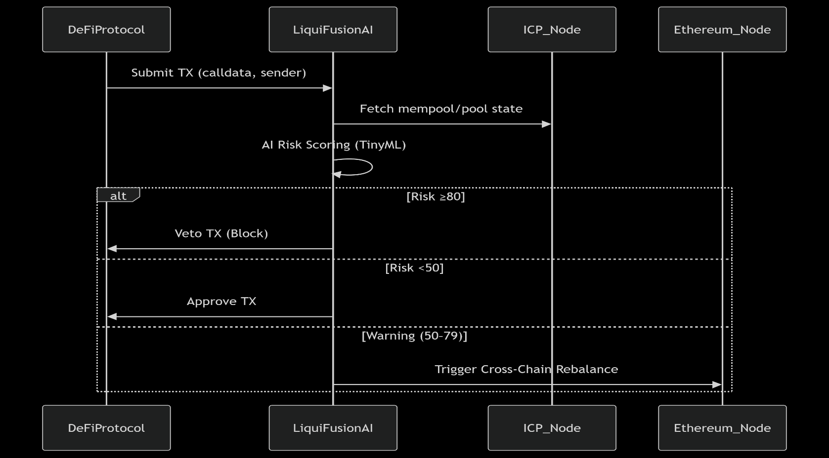
Making it happen (Use-cases)
4

Slide 7

Why Now?
5
On-chain AI
LiquiFusion works now because ICP and the blockchain space overall finally provide the deterministic speed, cross-chain orchestration, on-chain AI compute, and open data—plus the real user need—that make instant, autonomous, and fully verifiable DeFi security possible at scale. Previous technical and ecosystem limitations made this vision impossible just a few years ago.
Cross-chain Liquidity
Real-time Protection
Decentralized Security

Slide 8




Why are we the ones to do it?
6
Deepika v
Development & Management
Praveen Kumar s
Blockchain Developer
Uvasri K
Networking Specialist
Balaji v
AI & ML Developer

Slide 9











Where will we be next year if we win the hackathon/raise funds?
7
v3 Release
Close Partnership with Raydium, Orca
Hire Key Roles
Pre-release Marketing
Q1 (2024)
Q2 (2024)
Q3 (2024)
Q4 (2024)

Slide 10
Here is how we make/will make money...
8
2 - 10%
Per-Transaction Protection Fees
10 - 25%
Revenue Sharing With Protocols/Partners
20 - 40%
Governance Token/Protocol Fees
Enterprise API & White-Label Licensing: Offer LiquiFusion’s AI-powered risk scoring and optimization as a plug-and-play API or complete white-label module for wallets, custodians, and aggregator platforms—charging a usage-based fee or flat monthly license.
Compliance & Audit Services: Provide downloadable audit logs, automated compliance reports, and “real-time risk attestation” features as an optional paid service for DAOs, institutions, or protocols needing regulatory proof or external verification—billed as a one-time or recurring fee.

Slide 11


Praveen kumar S
CEO
praveensrinivasan05@gmail.com
+91 7358085171
Liquifusion
Smart cross-chain liquidity optimizer

